Slide 1
Operating Systems
Dr. Deepak Dembla

Slide 2
Disk Management

Slide 3
Objectives
Disk scheduling criteria
Various disk scheduling algorithm
( FCFS,SSTF,SCAN,CSCAN,FSCAN,NSCAN,LOOK,CLOOK)
Rotational Optimization
Disk scheduling algorithms based on rotational optimization
Disk Formatting
Bad Sectors
Swap space management
RAID structure

Slide 4
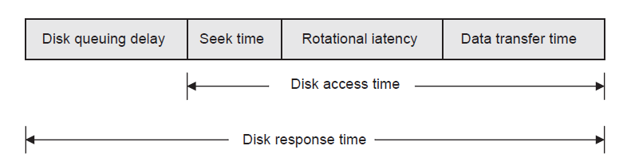
Disk I/O performance time factors

Slide 5
Disk scheduling criteria
Seek Time : Time taken by the disk head to move from one cylinder to another one.
Rotational Latency : Time taken by the addressed sector of the appropriate track to rotate into a position such that read/write head is accessible to it, i.e. the sector comes under the head.
Transfer time: actual time when the data to be read or written is transferred. The transfer time depends on the rotational speed of the disk and the number of bytes to be transferred.

Slide 6
Disk scheduling criteria
Disk bandwidth : The total number of bytes transferred divided by the total time between the first request of the service and completion of the last transfer of the data.
Throughput : Total number of disk requests serviced per unit time.
Response time : The average time spent in waiting by a disk request.
Variance of response time : To measure how individual requests are serviced relative to average system performance.

Slide 7
Desired disk performance parameters
Parameter | Desired performance
Seek time | Minimize
Rotational latency | Minimize
Transfer time | Minimize
Bandwidth | Maximize
Throughput | Maximize
Average Response time | Minimize
Variance of Response time | Minimize

Slide 8
Various disk scheduling algorithms
Algorithm | Criteria | Pros/cons
FCFS | The requests are scheduled in the order as they have arrived in the disk queue. | Fair Low throughput High average response time Low variance High seek time
SSTF | The request whose seek time is shortest will be executed first. | Reduced seek time High throughput High variance Starvation Unfair
SCAN | Services the requests in the direction of its head movement and continues until it reaches at the end of the disk | Good average response time Low variance High throughput Starvation
C-SCAN | Considers the queue of cylinders in a circular queue such that it starts scanning them in the queue and after reaching at the last cylinder it starts with the first one again. | High throughput Low variance Starvation

Slide 9
Various disk scheduling algorithms
F-SCAN | the new requests are deferred until all the pending old requests in the queue have not been processed. | High throughput Good average response time Low variance
N-SCAN | serve the requests at the interval of n in the queue in a sweep when the head is moving in one direction. | High throughput but low as compared to F-SCAN Good average response time Low variance
LOOK | the disk head looks ahead in its direction of movement for the last request, moves to the last request and changes its preferred direction there only and continues servicing the request. | Reduces seek time High throughput Low variance Good average response time
C-LOOK | treats the request queue as a circular queue, i.e. the disk head after reaching to the last request in its direction of movement returns back to the other end of the disk and reverses its direction and continues servicing the requests. | Low variance as compared to LOOK High throughput but low as compared to LOOK Reduces seek time Good average response time

Slide 10
Rational optimization
Rational Optimization considers the effect of rotational latency on the performance of the I/O operation on the disk
The rotational optimization based disk scheduling algorithms are dependent on the availability of disk configuration and other details.

Slide 11
Disk scheduling algorithms using
rational optimization
Algorithm | Criteria | Pros/cons
SLTF | examines all the requests in the queue and finds out the request having shortest rotational delay | Reduces the rotational latency High throughput Starvation
SPTF | considers the seek time as well as rotational latency together | Reduces the rotational latency High throughput Good average response time Starvation
SATF | the total access time is calculated for each request and shortest one is scheduled first. | High throughput Starvation

Slide 12
Disk formatting
There are 3 steps in disk formatting:
Low level formatting
Disk partitioning
Logical formatting
The low level formatting is performed by the manufacturer and the other two steps are performed by the operating system and therefore are linked to it.
The partition that contains the boot code is known as boot partition.

Slide 13
Disk formatting
The disk that contains the boot partition is called a boot disk or system disk.
The information regarding each partition is stored in one data structure known as partition table. The partition table stores the information about each partition such as its starting sector, size of each partition, etc.
The logical formatting operation lays down a boot block in the partition and creates a file system.

Slide 14
Bad sectors
The disk controller maps the bad sector to the spare one out of predefined spare sectors. This is known as sector sparing or forwarding.
Instead of mapping the bad sector to the spare sector, just shift all the sectors to bypass bad one. This is known as sector slipping.
The sector sparing and sector slipping discussed above can also be implemented by the operating system.

Slide 15
Swap space/paging space management
Swap space can be defined as a temporary storage location on the disk to implement the virtual memory when system’s memory requirements exceed the size of available main memory.

Slide 16
RAID Structure
The multiple disks may operate independently and in parallel to organize the data in various ways and redundancy of data can be there in order to have the reliability. This is known as Redundant array of Inexpensive Disks.
In RAID, the data is stored on separate disks as a strip. A strip may be a fixed size block on the disk.
The set of strips at the same location on each disk in the array is known as a stripe. The smaller sized strips are known as fine-grained strips whereas the large sized strips are called coarse-grained strips.

Slide 17
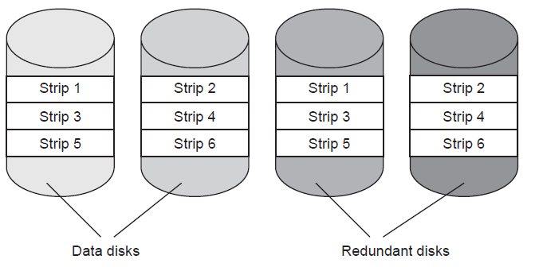
RAID Structure
RAID level 1

Slide 18
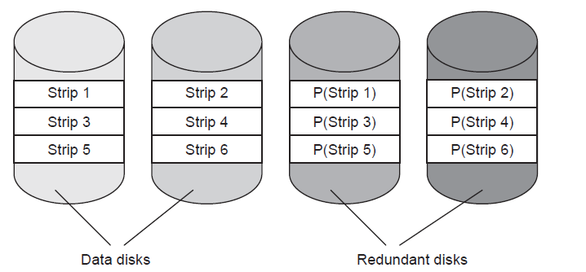
RAID Structure
RAID level 2

Slide 19
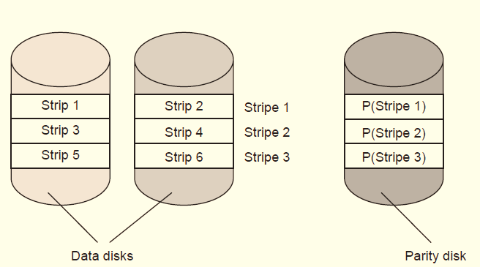
RAID Structure
RAID level 3

Slide 20
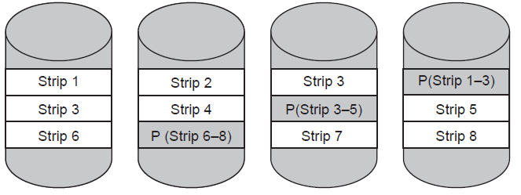
RAID Structure
RAID level 5

Slide 21
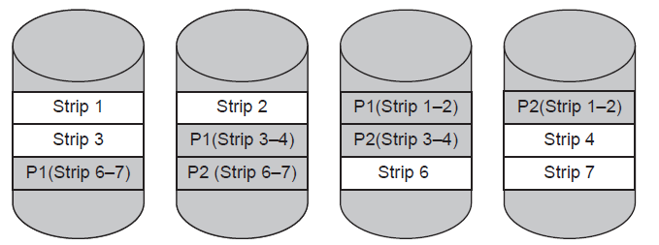
RAID Structure
RAID level 6

Slide 22
Levels of RAID structure
RAID level | Description | Pros/Cons | Disks required
0 | Striped Non-redundant | Simple to implement High data transfer High I/O request rate | n
1 | Mirrored Redundant | Increases data transfer capacity for read but not for write Increases I/O request rate twice for read but not for write | 2n
2 | Fine grained striping Redundancy through Hamming ECC | Highest data transfer capacity Increases I/O request rate twice | n + m

Slide 23
Levels of RAID Structure
3 | Fine grained striping Single parity disk Redundancy through XOR ECC | Highest data transfer capacity Increases I/O request rate twice | n + 1
4 | Coarse-grained striping Single parity disk Redundancy through XOR ECC | Low data transfer capacity Low I/O request rate | n + 1
5 | Coarse-grained striping Distributed parity Redundancy through XOR ECC | Low data transfer capacity Low I/O request rate | n + 1
6 | Coarse-grained striping Dual Distributed parity | Low data transfer capacity Low I/O request rate | n + 2

